Slide 1
Neural Collaborative Filtering for
Expert Recommendation
Neural Collaborative Filtering
Seyedeh Mina Mousavifar
Xiangnan He, Lizi Liao, Hanwang Zhang, Liqiang Nie, Xia Hu, and Tat-Seng Chua. 2017. Neural Collaborative Filtering. ​
Proceedings of the 26th International Conference on World Wide Web - WWW 17

Slide 2
Overview of Expert Recommendation
Community question and answer platforms have turned into repositories of knowledge
Leveraging expertise of users in Stack Overflow to provide high-quality solutions to a given problem
A large volume of questions are posted every day and it is challenging to identify the relevant qualified experts to answer these questions
1/23

Slide 3
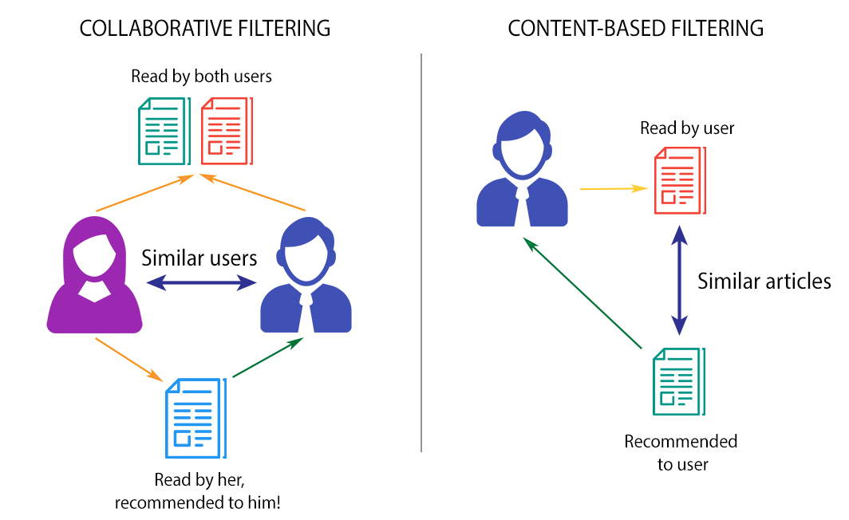
Recommendation
Recommender systems are algorithms aimed at suggesting relevant items to users.
Major paradigms of recommender systems
Collaborative methods
Content based methods
2/23

Slide 4
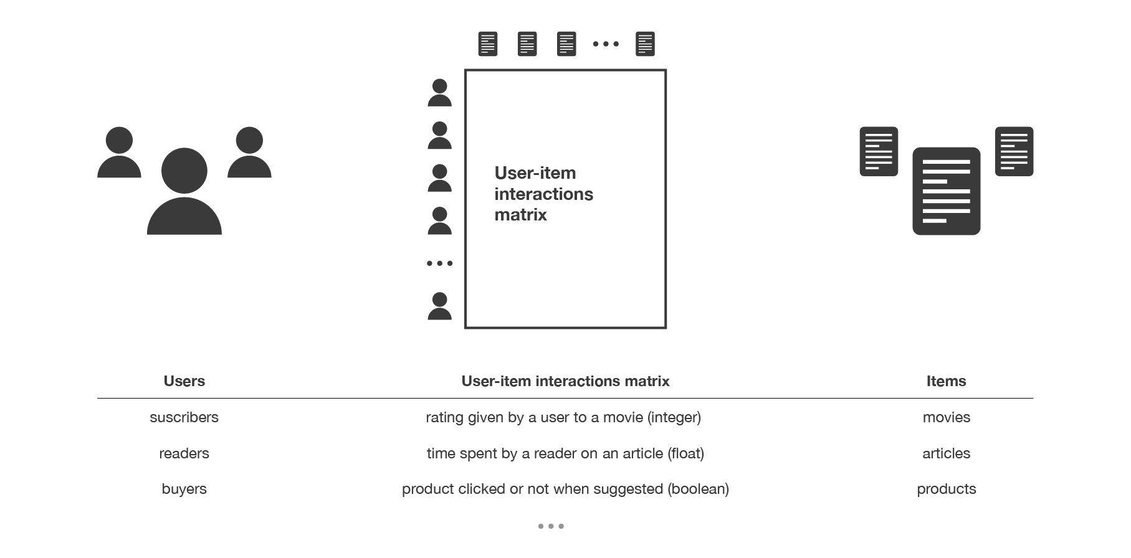
Collaborative Filtering
Based on the past interactions recorded between users and items to produce new recommendations.
These interactions are stored in “user-item interactions matrix”.
These past user-item interactions are sufficient to detect similar users or similar items and make predictions based on these estimated proximities.
3/23
Source: Introduction to Recommendation

Slide 5
Matrix Factorization
De-facto technique in collaborative filtering.
Projects users and items into a shared latent space, using a vector of latent features to represent a user or an item.
User’s interaction on an item is modelled as the inner product of their latent vectors.
Assumes that each dimension of the latent space is independent of each other and linearly combining them with the same weight.
Y. Koren, R. Bell, and C. Volinsky. 2009. Matrix Factorization Techniques for Recommender Systems.
4/23

Slide 6
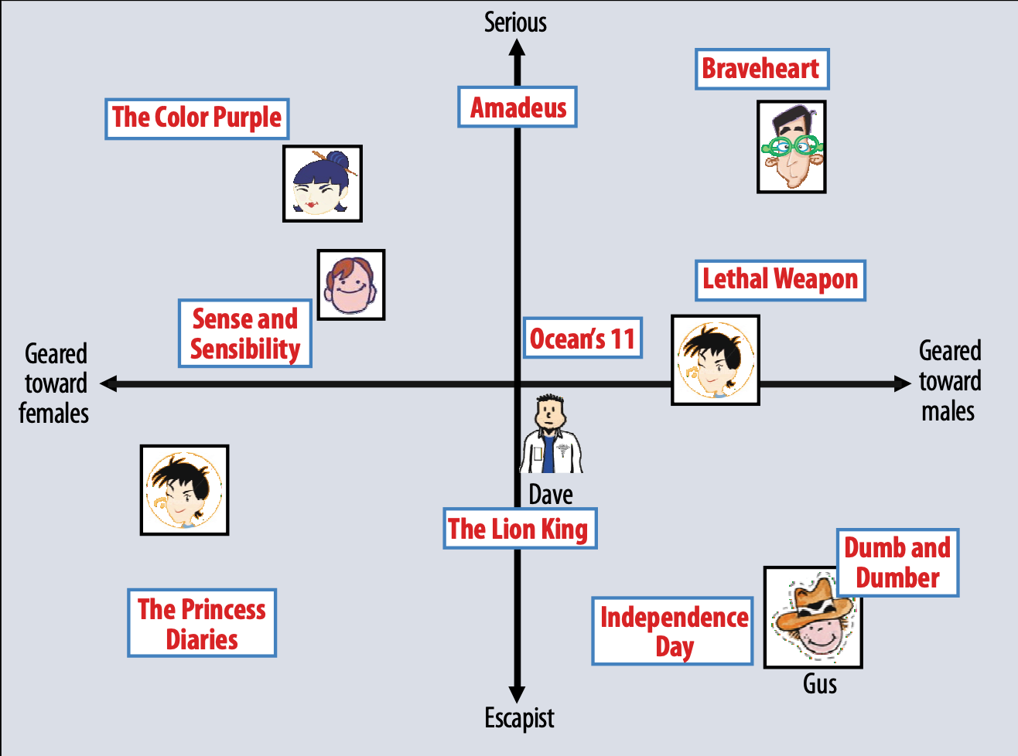
Matrix Factorization(MF)
A simplified illustration of the latent factor approach, which characterizes both users and items using two axes.
Y. Koren, R. Bell, and C. Volinsky. 2009. Matrix Factorization Techniques for Recommender Systems.
5/23

Slide 7
Recommendation Task
Expert recommendation in Stack Overflow community, using a collaborative filtering-based recommendation approach that combines traditional matrix factorization and multilayer perceptron.
Generalizing MF method and capture the non-linearity in the latent space.
Learning the complex structure of user interaction data, which is a massive sparse matrix, with lots of unknown cells.
6/23

Slide 8
Dataset
Stack Overflow dataset from "Stack Exchange Data Dump"
1 million users, 19 million posts
Subset of SO dataset
From January 2019 to January 2020
Users with more than 15 posts in this year
5,448 experts, 392,798 questions
Data collection, and cleaning
7/23

Slide 9
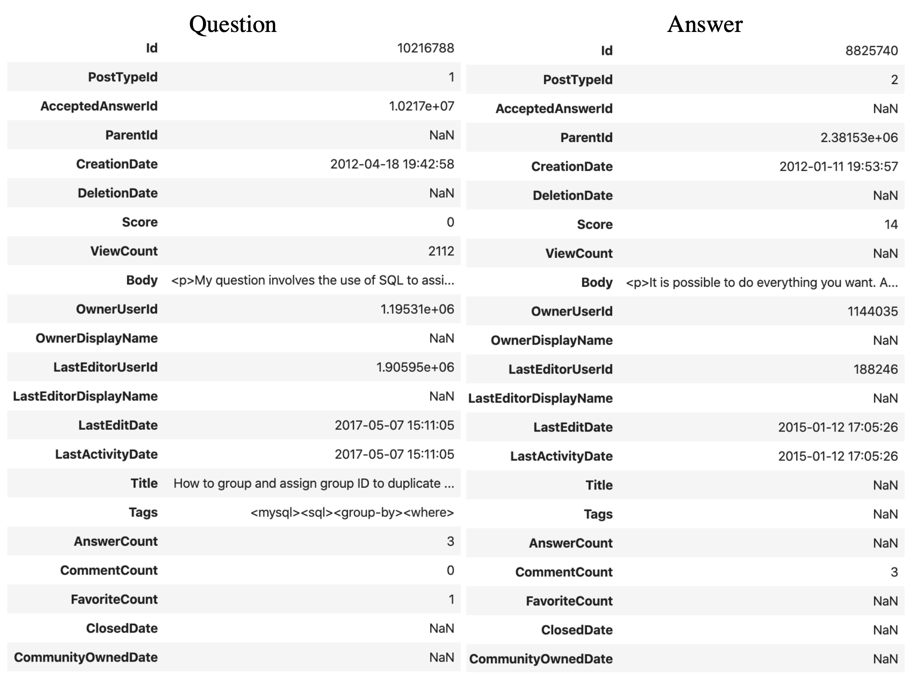
Dataset
Posts
8/23

Slide 10
Dataset
Expert-Question interaction overview
Expert-Question interaction matrix
Experts in rows
Questions in columns
1-hot encoding of experts who answer the question
Answers per User | Min | Mean | Max | STD
 | 186 | 8617.29 | 50000 | 7481.18
9/23

Slide 11
Evaluation Plan
Binary Cross Entropy Loss Function
Cast recommendation into a binary classification problem
Whether expert would answer the question or not
Experiment
Negative Sampling
For each question in test set, rank all users, including the user who has answered the question based on predicted value
Evaluation
Hit Ratio
Normalized Discounted Cumulative Gain
Baseline: MF
10/23
Notes:
Hit ratio: measures whether the test item is present on the top-10 list
NDCG: accounts for the position of the hit by assigning higher scores to hits at top ranks
Run experiment 10 times, average of such metrics

Slide 12
Neural Collaborative filtering
The paper introduces "Neural network-based Collaborative Filtering"(NCF) framework for recommendation
Evaluate this recommendation technique in StackOverflow for expert recommendation
Xiangnan He, Lizi Liao, Hanwang Zhang, Liqiang Nie, Xia Hu, and Tat-Seng Chua. 2017. Neural Collaborative Filtering. ​
Proceedings of the 26th International Conference on World Wide Web - WWW 17 ​
11/23

Slide 13
Main Contributions of NCF
Exploring Neural networks application in collaborative filtering
Generalizing MF method to learn a variant of MF that allows different importance in latent dimensions
Capturing non-linear interaction between user and item latent features
12/23

Slide 14
Related Work
R. Socher, D. Chen, C. D. Manning, and A. Ng. Reasoning with neural tensor networks for knowledge base completion. NIPS, pages 926–934, 2013.
Relationship in Knowledge base, reasoning over relationships between two entities using neural network
Y. Wu, C. DuBois, A. X. Zheng, and M. Ester. Collaborative denoising auto-encoders for top-n recommender systems. WSDM, pages 153–162, 2016.
Introducing Collaborative Denoising Auto-Encoder (CDAE), learning hidden structures that can reconstruct user’s ratings given history, applies a linear kernel to model user–item interactions.
H.T. Cheng, L. Koc, J. Harmsen, T. Shaked, T. Chandra, H. Aradhye, G. Anderson, G. Corrado, W. Chai, M. Ispir, et al. Wide & deep learning for recommender systems. 2016.
App recommendation, combining wide linear models for generalization and deep neural network for memorization
13/23

Slide 15
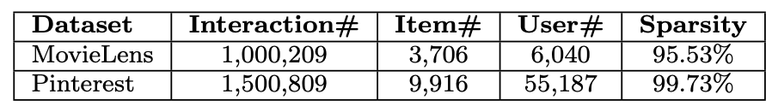
Data
MovieLens: Movie rating dataset
Widely used for evaluating collaborative filtering methods
Extract interaction matrix based on whether has rated the item
Pinterest: Pinterest social network dataset
Introduced for evaluating content-based image recommendation
Extract interaction matrix based on whether has pinned an item
14/23

Slide 16
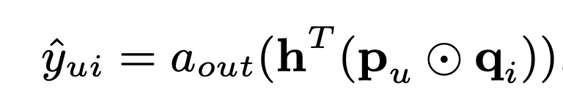


Generalize Matrix Factorization(GMF)
Learning a variant of MF that allows varying importance of latent dimensions
is user latent features as one-hot encoding of user ID
is question latent features as one-hot encoding of user ID
Recover MF by enforcing h to be uniform vector of 1
Loss function
Binary Cross Entropy
Optimization
Adam
Initialization
Random from Guassian distribution
15/23
Notes:
Intuitively, if we use an identity function for aout and enforce h to be a uniform vector of 1, we can exactly recover the MF model.

Slide 17
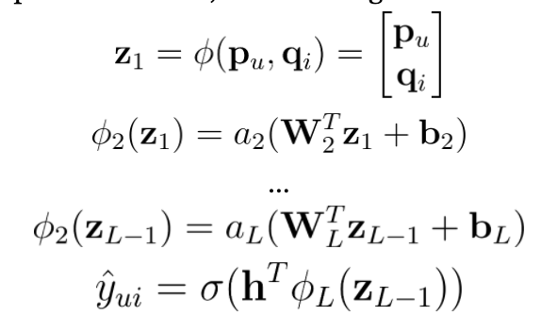
Multi-Layer Perceptron(MLP)
Multi-layer perceptron to learn the interaction between experts and questions latent features
Three fully connected layers, with the bottom layer having the largest neurons and halve the neurons for each layer
Loss function
Binary Cross Entropy
Optimization
Adam
Initialization
Random from Guassian distribution
Activation
Relu
16/23
Notes:
As for network structure design, a common solution is to adopt a tower model, where the bottom layer is the largest and each successive layer has fewer neurons to learn more abstractive features of the data by using a small number of hidden units for higher layers.

Slide 18
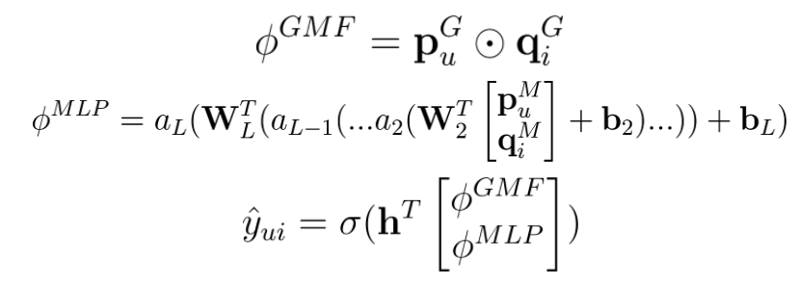
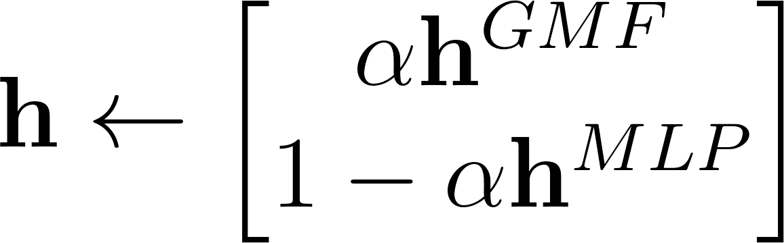
Fusion of GMF and MLP (NeuMF)
Combine the two models by concatenating their last hidden layer.
Loss function
Binary Cross Entropy
Optimization
SGD
Initialization
17/23
Notes:
GMF applies a linear kernel to model the latent feature interactions and MLP uses a non-linear kernel to learn the interaction function from data.

Slide 19
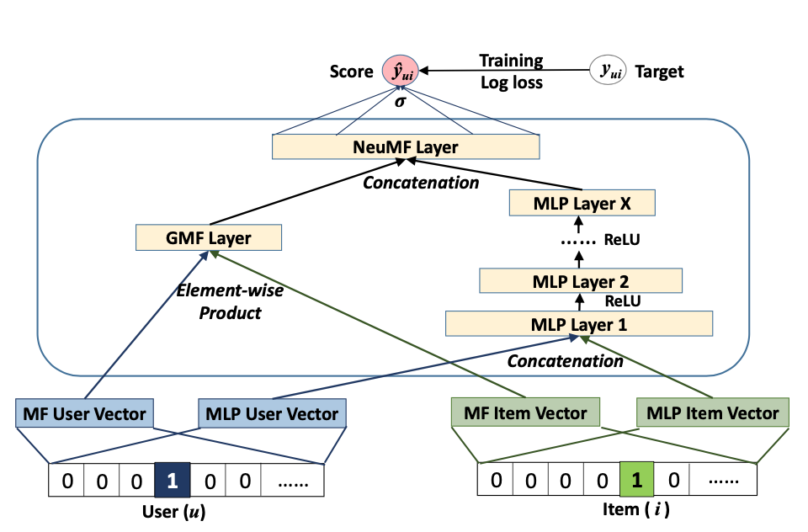
NCF framework Architecture
18/23

Slide 20
Evaluation
Leave-one-out method held out the latest interaction for each user as the test set and utilized the rest for training.
Randomly sample 100 items that are not interacted by the user, ranking the test item among the 100 items
Rank-based metrics at 10:
Hit Ratio(HR) measures whether the test item is present on the top-10 list
Normalized Discounted Cumulative Gain(NDCG) accounts for the position of the hit by assigning higher scores to hits at top ranks.
19/23

Slide 21
Evaluation
Baselines
ItemPop: Non-personalized method to benchmark the recommendation performance, rank items based on popularity
ItemKNN:item-based collaborative filtering method
BPR: a highly competitive baseline for item recommendation, optimized MF by using pairwise ranking loss
eALS: state-of-the-art MF method for item recommendation, optimize L2-norm of classification error
20/23
Notes:
optimize l2-norm of classification error, treating all unobserved interactions as negative instances and weighting them non-uniformly by the item popularity

Slide 22
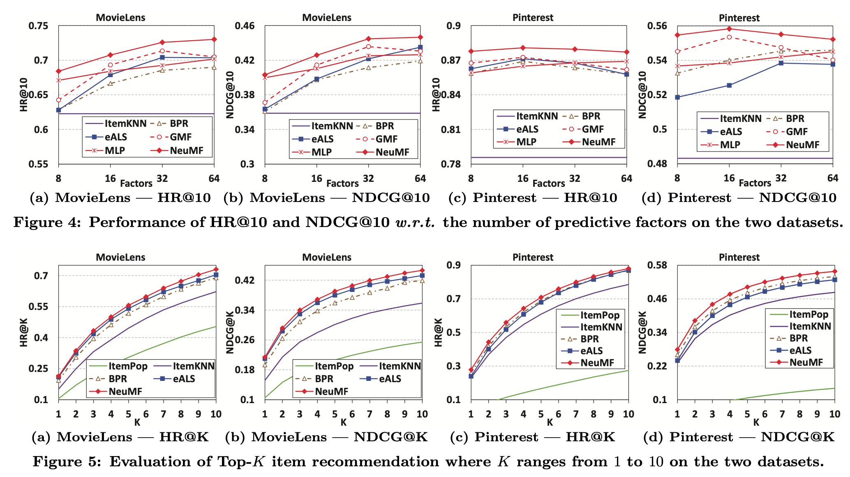

Evaluation Summary
NeuMF achieves the best performance on both datasets, significantly outperforming other methods by improving eALS 4.5% and BPR 4.9%.
21/23

Slide 23
How do the results in the Research Paper affect your Course Project
Evaluating proposed method for expert recommendation
Applying to SO dataset
Solving the same recommendation based on collaborative filtering
Goal: proceed to a hybrid method using state-of-the-art collaborative technique and content-based technique
22/23

Slide 24
Overall Summary
Introducing a generic neural network architecture for collaborative filtering
NCF opens a new avenue of research possibilities for recommendation based on deep learning
Evaluating NeuMF for expert recommendation
23/23

Slide 25
Questions?
Thank you

